Slide 1

+
Next Steps in Sustainable Procurement:
Level 3 of the Flexible Framework
Michelle Dixon - Director
Aston University, 13th April 2010
Notes:
Print:
Strategies
2 copies of procuring the future
GPP material – have folder

Slide 2
+
Workshop overview
Recap on the context, principles and practice of sustainable procurement
Update on recent developments and guidance
Participative workshop on the key objectives at Level 3 of the Flexible Framework
Discussion on making progress in the sector

Slide 3
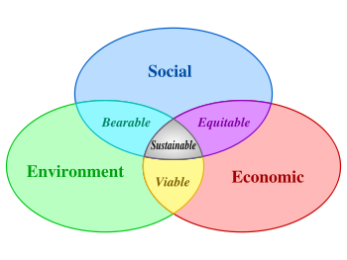
+
Recap on sustainable procurement principles
Minimising environmental and social impacts of purchases in balance with economic factors
“Procurement to support wider
economic, social and environmental
objectives in ways that offer
real long-term value”.
UK Government
Sustainable Procurement
Task force

Slide 4
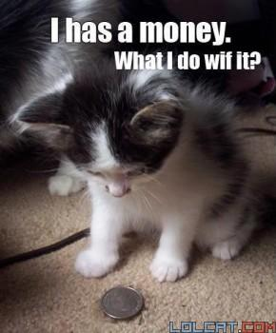

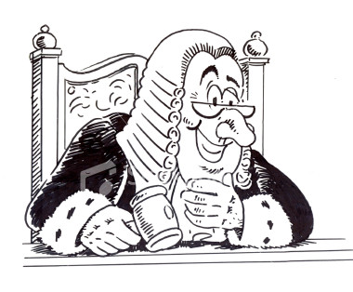


Notes:
Why should we adopt sustainable procurement?
+ Core sustainability issue
+ Cost savings
+ Corporate Social Responsibility and reputation
+ Duty of Care responsibilities
+ Simply good procurement practice!

Slide 5

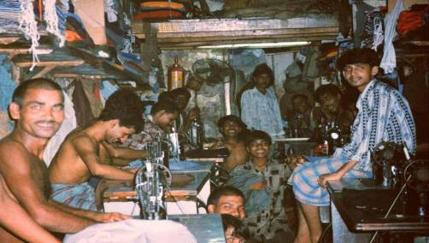
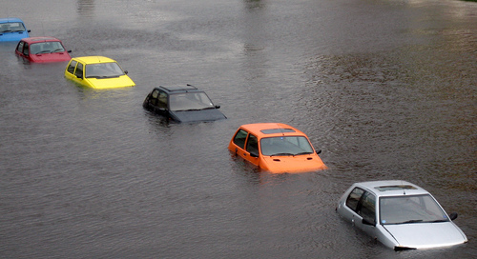
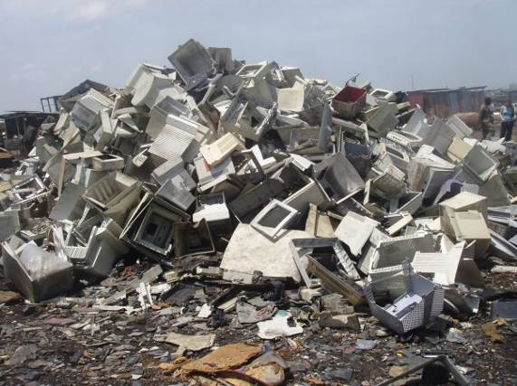
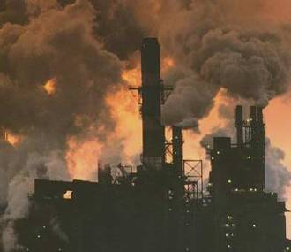

Notes:
Central sustainability issue
Human health – avoiding hazardous chemicals, promoting good diet
Fair working conditions – pay, working hours, equality, child labour
Pollution prevention – avoiding release of hazardous substances to air, water and land
Energy consumption and climate change – low energy production and product design, transportation of goods - measuring the UK’s carbon footprint by consumption rather than production – which includes the carbon emissions associated with the manufacture and transportation of these products - increases it by 34%
Water consumption – efficient production and product design
Use of natural resources and production of waste - reduction in packaging, use of recyclable and recycled material, end of life disposal,
Protection of biodiversity – sensitive extraction of raw materials e.g timber, soy, palm oil

Slide 6

+
Hidden costs
240 kg (530 pounds) of fossil fuels
22 kg (48 pounds) of chemicals
1.5 tonnes of water
60kg waste
81% of the energy consumed during a computer’s life cycle is during production
Notes:
Figures based on a UN study

Slide 7

+
Our society must adapt!
Notes:
We need to change the way we consume and the amount we consume in order to sustain our growing population (9 billion by 2050, currently approaching 7 billion)
If everyone consumed the amount of resources as we do in the UK we’d need three planets to support us. If everyone consumed as much as people in the USA we’d need 6 planets.

Slide 8




+
Strategies and Targets
“ A university’s procurement policy is one of its strongest ways of supporting sustainability”
“The UK should be a leader in sustainable public procurement in the EU by 2009
The Flexible Framework - Level 3 with area in level 5 by 2009
50 % Green public procurement (GPP) to by 2010

Slide 9




+
Strategies and targets
Low carbon procurement a priority for delivering low carbon economic activity
Scope 3 emissions baseline for HE by 2012, emissions reduction target by 2013
Most Universities will have to buy carbon allowances and will be rewarded and penalised on performance.
All new non-domestic buildings should be zero carbon from 2019, with the public sector leading the way from 2018.
Notes:
2008 Grant Letter from the Secretary of State:
HEFCE should work with the sector to make sure it reduces carbon in line with national target
All institutions in receipt of capital funding should have a carbon management plan
Performance against these plans should be a factor in future capital allowance
HEFCE Carbon Reduction Strategy and Target
outlined the carbon management plan requirement
HEFCE Carbon Reduction Strategy and Target
outlined the carbon management plan requirement
set a sector wide carbon reduction target
Institutions are required to set targets for scope 1 and 2 emissions that result from energy use
Scope 3 emissions includes procurement – HEFCE aims to establish a baseline of emissions from procurement by December 2012 and this will be followed by target(s) for scope 3 emissions being set by December 2013.

Slide 10
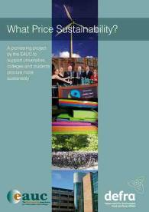


+
Sector Response
EAUC Sustainable Procurement Project
EAUC CPD Training
Build capacity , influence supply chains; address process issues; develop measurement and monitoring tools
Notes:
EAUC Sustainable Procurement Project (Environmental Action Fund (EAF)), 2005-8
80% increase in sustainable purchasing policies and strategies being present in partner institutions.
Engagement with suppliers on environmental and social issues increased from
20% to 100%
Key Learning's
1. It is clear from the project that whist the Flexible Framework is a useful tool there
was confusion on how to use it and apply it in an FHE environment.
Recommendations
1. Further work needed to benchmark FHE against the Flexible Framework.
2. Further guidance and support is developed on using the Flexible Framework in an
FHE environment.

Slide 11

+
The Flexible Framework – Building Blocks for Progress
+ Building blocks for progress – key behavioural and operational change programmes, the facets of good procurement across 5 levels
People
Policy, Strategy & Communications
Procurement Process
Engaging Suppliers
Measurement & Results.

Slide 12
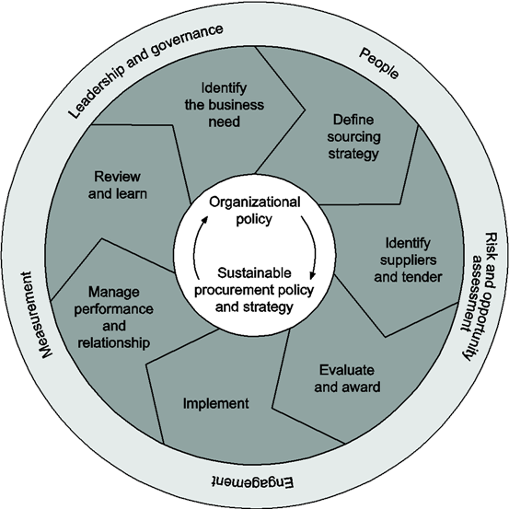
+
Recent developments: BS8903
Notes:
BS 8903: Fundamentals, Procurement Process, Enablers
First detailed guidance for implementing sustainability procurement programmes
Links directly to the Flexible Framework
Overcomes some interpretation issues with the Flexible Framework
Provides more in-depth guidance on basic and advanced principles with case studies
Assists with implementation of the Flexible Framework at more advanced levels

Slide 13
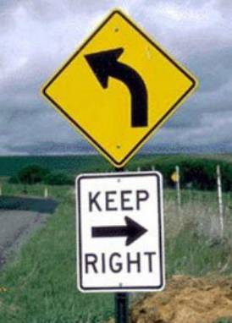
+
Key objectives: Level 3 of the Flexible Framework
  Advanced/refresher training, performance objectives and incentives
  Producing a Sustainable Procurement Strategy
  Managing risks throughout the procurement process
  Promoting continuous improvement in the supply chain

Slide 14
+
Sustainable procurement strategy
The FHE sector is in its infancy in developing Sustainable Procurement Strategy
Wider public and private sector examples
The Flexible Framework asks for some specific content:
  Focus on risk
  Process Integration
  Marketing
  Supplier engagement
  Measurement and review process

Slide 15
+
Risk and opportunity
Sustainability risk and opportunity
Key impacts
Financial
Reputa-tion
Legal risk
Security of supply

Slide 16

+
Process integration
Adopt an integrated approach:
Make links with wider policy, strategy and procedures
Software solutions
Collaboration with suppliers
Also consider new technology and innovation:
Drive improvements throughout product life cycles

Slide 17
+
BS8903
Notes:
BS8903 diagram and process integration

Slide 18
+
Marketing and Communication
Stakeholder analysis and multidimensional approach:
Group exercise:
Who do you need to communicate your programme ?
What activities would you undertake in year 1 of the strategy?
Notes:
Who do you need to communicate to?
All staff
Senior Managers and Governors
Students – current and potential
HEFCE
Suppliers
General public
Within the your strategy include a range of activities according the behaviour change diamond.
The behaviour change diamond features in the UK Sustainable Development Strategy and Procuring the Future

Slide 19
+
Sustainable procurement strategy
Formulate objectives and targets:
Think:
Specific - e.g reduce waste and increase recycling through the waste contract
Measurable - e.g reduce waste by 10%
Accountable - e.g waste manager and procurement officer
Realistic - what technology, finance and time is available?
Time bound – by 2011

Slide 20
+
Some suggestions on structure
Explain concept and principles at outset
Present some initial analysis: e.g.
Impacts of the procurement process?
What are the risks to the organisation?
What are your high risk contracts?
Include highlights of your achievements to date
Use your policy and/or the flexible framework in structuring the document
In each area explain your overall approach and then outline objectives and targets in appendices ?
Senior Management Foreword

Slide 21
+
Plan for the Short, Medium and Long Term
Short Term
Medium Term
Long Term
Notes:
Short term – enable progress, provide a good example
Medium term – look at new technologies
Long term – set some aspirations e.g zero waste and carbon

Slide 22
+
Producing the strategy
Group exercise:
Review the example strategies
In groups discuss your ideas on how you would structure your strategy
How do you make sure that the document in implemented
Individually produce a contents page for your strategy
Notes:
Group discussion: Potential outline strategy
Total Length – around 10-12 pages
Front cover – include a relevant picture/design, think about your audience.
Foreword – ideally from your VC. The foreword should outline why sustainable procurement is important to the organisation and show support, engagement and encouragement. Work in partnership with your VC to produce this.
Introduction/Context – What is Sustainable Procurement? Why is it important? Your current achievements and progress in the Flexible Framework, a case study.
Drivers and risks (You could also include this in the introduction but it may be better to break the two sections up) – include information relevant to the organisation on Financial, Legal, Reputation, Security of Supply risks and drivers.
Scope and vision – outline your overall approach and headline targets, details on key contracts and environmental impacts of procurement process.
Governance and review process – outline staff responsibilities for strategy implementation, possibly illustrated in a diagram – who are the champions, committees, responsible senior managers? Commit to annual review of strategy and policy and name the group responsible for this.
Objectives and targets – use the Flexible Framework as headings and your Policy commitments as subheadings. Ensure that your O&T’s meet level required. Use SMART targets.
Any further information or reading. Links to key documents and tools.

Slide 23
+
People: Training
Requirements:
Targeted refresher training
Performance objectives
Simple incentives
Level 3 ‘Measurements and results’ also requires measures to be linked to be individual procurer development objectives.
Who do you target?
Include as a minimum:
Key procurement staff
High risk contract managers

Slide 24
+
Training: What do you cover?
Include recap and more in-depth workshop on embedding sustainability in the procurement process tailored to specific areas of work:
Identifying need
Suppler selection/sourcing
Production of specification
Apply tools that you have introduced:
GPP material
Forum for the Future
Specific training:
Sustainable Procurement 2010
BS9803
Measuring and monitoring carbon emissions

Slide 25
+
People: development objectives and incentives
Building competence and responsibility is crucial to enable best practice
Outline in your strategy as part of your objectives and targets
Development objectives may relate to
Learning and development needs
Specific aspects of Policy implementation
Specific high risk contract procurement and management
Implementation of specific processes e.g application of criteria and WLC
Ultimate incorporation into job descriptions?
Group exercise: In groups produce a list of specific development objectives that could be applied. Individually draft a list of staff members to apply the targets to. Are there any incentives that could apply?

Slide 26
+
Procurement Process
Requirements:
All contracts assessed for general sustainability risks
Management actions identified
Manage risk throughout the procurement process

Slide 27
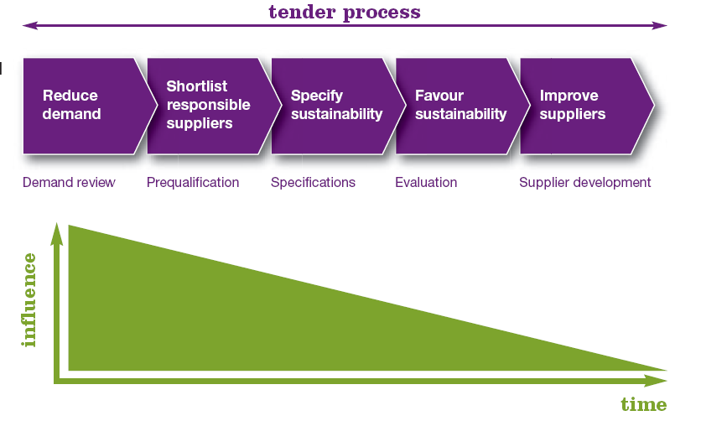

+
Manage risk throughout the procurement process
Management action at an early stage in the procurement process is vital!
Notes:
Possibly, the specification has more influence than indicated by this diagram?

Slide 28
+
Assessment of sustainability risks
What criteria have you used to undertake your risk assessment?
High - Legislation applicable, extensive natural resources use/ pollution/ transportation/ threat to habitats/human rights issues
Med – No applicable legislation but some natural resources use/ pollution/ transportation/ threat to habitats/human rights issues
Expenditure - high medium and low to expenditure category
Reputation
Security of supply
Notes:
You may want to include some additional sustainability risks in your risk assessment

Slide 29
+
Assessment of sustainability risks
Is any stakeholder concern evident?
Management
Employees
Students
Local Community
Local Authorities/ Environment Agency
Strategic Business Partners
Professional Bodies
Funding Bodies
Input to risk register – would this effect your high risk contract list?

Slide 30
+
Manage risk throughout the procurement process
Identification of need – can you reduce consumption?
Supplier selection/sourcing - what sustainable options are available? what legal , reputational and long term financial issues apply?
Production of specification – ensure all sustainability requirements are included and related to the subject matter, relate to overarching sustainability objectives.
Notes:
Refer to BS8903 Draft for further information on Procurement Process

Slide 31
Pre-qualification – general questions and also tailored to the specification and overarching sustainability objectives, site visit?
Tender issue and evaluation – relating to your specification: apply sustainability minimum standards, evaluation criteria and weighting with pre-defined scoring methodology, Whole Life Costing, Life Cycle Assessment and Supplier Audit, sustainability staff part of interviews/site visits
Contract award and implementation– good news stories, inform unsuccessful suppliers in relation to sustainability, KPI’s and action plans
Manage performance – review meetings, balanced scorecard methodology

Slide 32
+
Manage risk throughout the procurement process
In groups outline some examples of how you could apply management actions throughout the procurement process to some of your high risk contracts. Translate these actions into objectives and targets.
Example: Identification of need.
High risk contract: Copier Paper
Reduction of need through utilisation of electronic resources
Implement ‘think before you print’ campaign for support and academic staff by July 2010
Reduction of need through duplex printing
Procure duplex printing units for 50% of LRC printers by Dec 2010: Responsibility: Procurement assistant and LRC technician
Reduction in incentives for bulk buying
Discontinue incentives for bulk internal reprographics by Dec 2010. Responsibility: Procurement Assistant and Head of Reprographics
Notes:
Refer to the EU GPP Key commodity guidance throughout the tender process
European Commission, GPP Toolkit. Training, Action Planning, Criteria – Legal and Practical
http://ec.europa.eu/environment/gpp/toolkit_en.htm

Slide 33
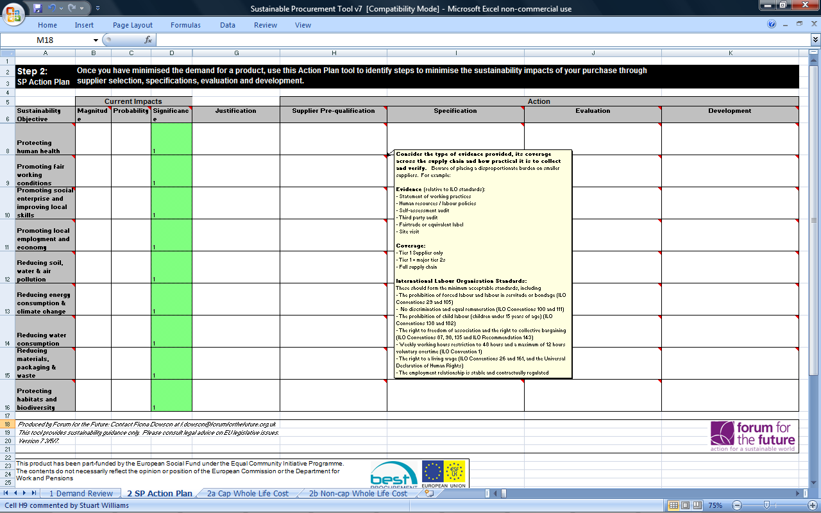
+
Action Plan Tool
Notes:
Forum for the Future Action Plan tool: This tool provides general guidance on defining management actions throughout the procurement process.
+ Forum for the Future, Sustainable Procurement tool. Available on request
http://www.forumforthefuture.org/node/1407

Slide 34
+
Supplier engagement
Requirements:
Targeted supplier engagement programme in place, promoting continual sustainability improvement
Two way communication between procurer and supplier exists with incentives.
Supply chain mapping for key spend areas

Slide 35
+
Promoting continuous improvement in the supply chain
Focus on high risk contracts:
Two way communication at monthly/quarterly review
What are your suppliers objectives and targets?
Is there an EMS in place. Any other British Standards?
Request periodic performance reports
Publicise good practice
Specific initiatives and programmes
Agree targets
Process improvement e.g. reduction in waste, carbon
Business management e.g. Implementation of an EMS, Procurement Policy
Operational improvement e.g. delivery days, minimum order value
Behaviour change e.g. Competitions, website design
Core list products

Slide 36
+
Supplier engagement
Level 1-2 Supplier engagement
Supplier engagement DEFRA's Story
The Approach – developed gradually through consultation
- Annual Conference with awards
- Quarterly Supplier Fora
- Group Workshops
- Individual workshops
- Sustainability action plans
- Involvement in wider sustainability strategy

Slide 37

+
Supplier engagement
Support and advice for businesses and organisations to help them reduce their sustainability impact:
Toolkits
Accreditation
Awards
Newsletter
Free consultancy
Promotional opportunities
http://www.greenprocurementcode.co.uk/
Notes:
Also look at regional development agencies and local regional remade networks – help for suppliers to win contracts

Slide 38
+
Promoting continuous improvement in the supply chain
Group exercise:
For your commodity areas outline a range of objectives and targets for your supplier engagement programme to promote continuous improvement in the supply chain.
What incentives would you use to drive improvements.

Slide 39
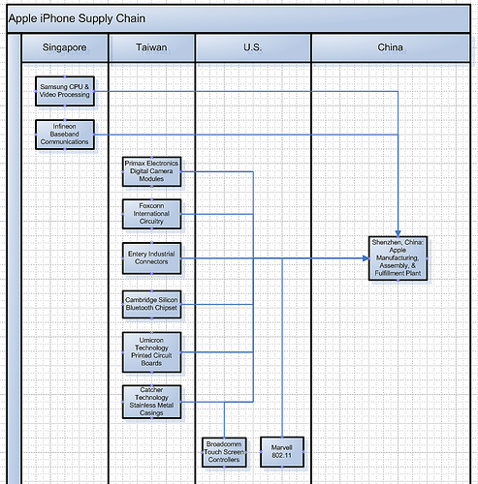
+
Supply chain mapping
+ Focus on key spend areas
+ Allows identification and engagement with suppliers and processes in the supply chain
+ Can form the basis of life cycle assessment
+ Work in partnership with key suppliers
+ Keep it simple

Slide 40
+
Related Guidance
+Forum for the Future, Buying a Better World
+ European Commission, Buying green! A handbook on environmental public procurement.
+ Forum for the Future and HEPS , Purchasing for Sustainability Guidance for Higher Education Institutions.
+ OGC, Social Issues in Purchasing.
+ OGC, Buy green and make a difference.
+ WRAP, Sustainable Procurement: Regional Guidelines, Sustainable Procurement: Making it happen.

Slide 41
+
Implementation Tools
+ EAUC Training Materials – Policy and Strategy, Social Issues, Supplier Engagement, Risk Based Approach, Train the Trainer
http://www.eauc.org.uk/training_materials
+ Forum for the Future, Sustainable Procurement tool. Available on request
http://www.forumforthefuture.org/node/1407
+ European Commission, GPP Toolkit. Training, Action Planning, Criteria – Legal and Practical
http://ec.europa.eu/environment/gpp/toolkit_en.htm
+ WRAP, Sustainable Procurement: Regional Guidelines, Tools
http://www.wrap.org.uk/nations_and_english_regions/english_regions/regional_case_studies_and_projects/sustainable_procurement_regional_guidelines/tools.html

Slide 42
+
Implementation Tools
+ DEFRA. Buy Sustainable - Quick Wins.
http://www.defra.gov.uk/sustainable/government/what/priority/consumption-production/quickWins/
+ Efficiency Measurement Model
http://www.procureweb.ac.uk/2153
+ Public Sector Food Procurement Initiative, Food Procurement Tools.
http://www.defra.gov.uk/farm/policy/sustain/procurement/resources.htm
+ Action Sustainability, Evaluation Tool.
http://www.actionsustainability.com/evaluation/flexible_framework/

Slide 43
+
Help and assistance
Delivering Sustainable Resource Solutions
Michelle Dixon – Director
Tel: 0845 643 1783
Mob: 07595 820660
Email: michelle.dixon@revise-eu.com
Web: www.revise-eu.com

