Slide 1

The Concordat for the Environmental Sustainability of Research and Innovation Practice
Jo Allatt, Head of Sustainability, UKRI
Kerry Garfitt, Senior Funding Policies Adviser, Wellcome Trust

Slide 2

“Research and innovation is key to both understanding the impact climate change and biodiversity loss is having on our planet and how to solve these challenges.”
Notes:
Research and innovation play a critical role in ensuring we understand how our planet is changing and is helping to solve the challenges we face
Academia is the home of research and innovation – through our research and knowledge exchange we’re able to innovate to create breakthrough solutions develop new knowledge and understanding that can shape how we tackle sustainability challenges.
Quote from
Concordat for the Environmental Sustainability of Research and Innovation Practice (wellcome.org)

Slide 3

“We need to change how we conduct research & innovation…
[we need to] to reduce and eliminate our own environmental impacts and emissions and achieve the transition to sustainable practices”
Notes:
BUT
we must all recognise that every activity we undertake across the research and innovation sector has its own impact on the environment, regardless of its contribution to solving challenges and this is something as a sector we need to better understand and address.
With the introduction of the Concordat for the Environmental Sustainability of Research and Innovation Practice, research organisations are being asked to mobilise the research and knowledge exchange community to take sustainability action.

Slide 4
Concordat for the environmental sustainability of Research & Innovation practice
Collaboratively developed by HEIs, research organisations and funders
A common environmental sustainability ambition to progressively embed environmental sustainability into all R&I practices.
Wellcome Trust are currently hosting the concordat on behalf of the sector. https://wellcome.org/what-we-do/our-work/environmental-sustainability-concordat.
Sets the standard for sector-wide culture change: action needed at all levels
Sector-wide oversight group currently being set-up (more later)
Notes:
A bit of background on the concordat
2 years ago UKRI started a journey of engagement and collaboration with sector stakeholders to find shared solutions for sector-wide cultural change to help embed environmental sustainability
UKRI - a key funder in the sector. We recognise that with a £8.7bn budget and a varied target audience who receive that funding, that we are well placed to influence the research and innovation (R&I) sector
Research and innovation is not just limited to universities and research institutes, there are many other important stakeholders involved, from funders through to businesses doing R&D.
Strength in funders, universities, institutes working together and exchanging our knowledge and the solutions and problems we face as we address the challenge of making research environmentally sustainable.
The concordat is fundamentally a framework for delivering change. It recognises that change needs to occur at many different level, from leadership down to individuals (and everything in between)
Change also needs to happen in many parts of the sector
The way we set out strategic expectations and rules
The way we run our infrastructure
Our expectations of each other, our peers
The way we design and approach things – just because we or our peers have always done it one way, doesn’t make it right for now and the future – we are living in a changing climate and we must also change.

Slide 5
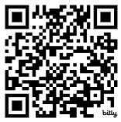
Concordat priorities
Sustainable
Research &
Innovation
Practice
Leadership
&
System Change
Sustainable
Procurement
Env. impact
&
reporting
Collaborations
&
Partnerships
Emissions
from Travel
Sustainable
Infrastructure
Signatories
Supporters
ES Concordat
bit.ly/3z0F9Hx
Notes:
Concordat was published 25 April 2024
It is a framework for action that asks signatories to
recognise the need to change how we conduct research and innovation as well as promote wider solutions
agree to take shared action now and in the future to reduce and eliminate our own negative environmental impacts and emissions and achieve the transition to sustainable practices.
What the concordat is trying to achieve: By 2050 (or 2045 in Scotland) the UK R&I sector will have in place:
Visible and credible leadership for sustainability at all levels within institutions and across the sector.
Research and innovation that is carried out in the most sustainable way possible, transparent about its environmental impacts and open to collaboration and shared learning.
New ways of working so that institutions and researchers continue to achieve a global reach and deliver world-leading impact in R&I using a climate conscious, low carbon approach to travel.
A majority of net zero or near-net zero infrastructure used for R&I.
Robust decisions made in resourcing R&I projects and responsible sourcing demanded all through supply chains.
A shift to use of reusable products and innovative developments in single use materials to reduce the use of fossil fuel-based products used in practicing R&I to only those areas where there is no viable alternative.
Our collaborative journey so far has been met with enthusiasm and support from people in roles and organisations across the sector.
These are so far just words, and while nice to hear, we now need action.
The concordat publication marks an important step forward in our journey, but I’m now looking forward to the next chapter and seeing what impact we can really make as a sector as we come together and take joint action to embed sustainability into research and innovation practice.

Slide 6
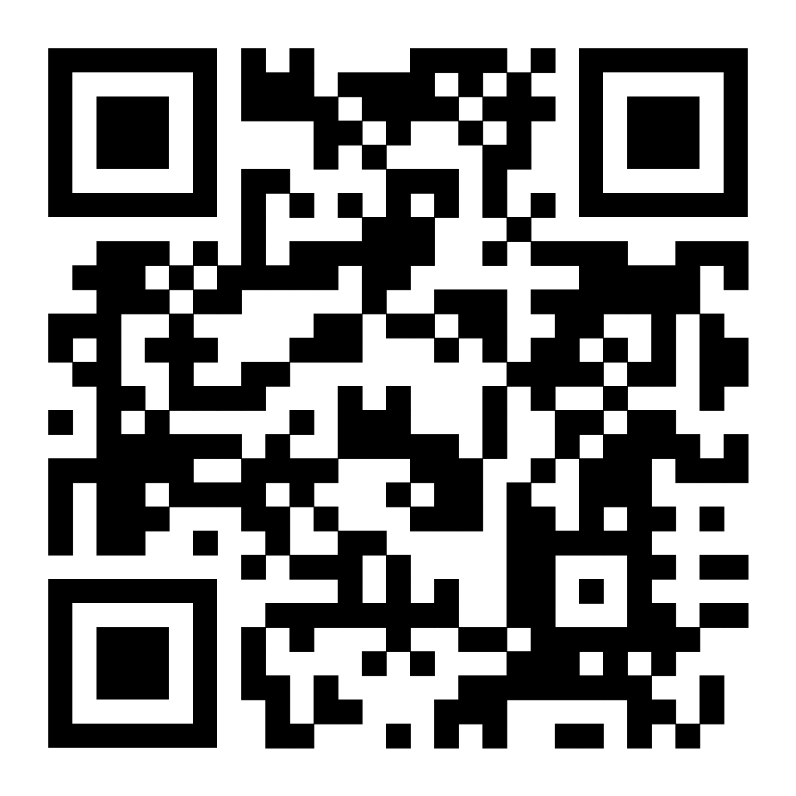
Signing up to the Concordat
Signatories:
agree to all six priority areas
organisations can develop a plan for delivery against these after signing – they don’t need to delivering at the point of signing
signing is a statement of intent.
Supporters:
agree with the aims and many of the priority areas
are not able to commit to being a full signatory at this time
they can become signatories whenever they are ready (or can remain supporters).
So far:
44 Signatories
17 Supporters
Sign up here: https://wellcome.org/who-we-are/positions-and-statements/environmental-sustainability-concordat
Notes:
Is a web address best here for sign ups? Is there a better way? I could ask our coms team to put a QR code here?

Slide 7

Concordat Oversight Group

Slide 8
Concordat Oversight Group
Continuing the sector-wide collaboration, ensuring the concordat is collectively owned.
Will assess if the concordat is meeting its aims. Is change happening? Do other things need to happen so it will meet its aims?
Group will be representative of the whole Research and Innovation sector HEIs, Research Organisations, funders, representatives from across the UK from organisations of a variety of sizes.
Chaired by Simon Denegri, Executive Director, Academy of Medical Sciences
Notes:
As mentioned earlier, a concordat oversight group is being set up.
Earlier we heard about the need for sector wide culture change and action needed at all levels. The oversight group will review evidence from various sources and make recommendations to the sector on what further action needs to be taken to ensure the concordat’s aims are met.
Just like the initial work to create the concordat, the oversight group needs to include representatives from across the UK R&I sector – HEIs, research organisations and funders. It also needs to make sure the views of organisations of different size and from across the four nations are represented. It needs to be large enough to do this and still small enough to function effectively.
To get the group up and running, UKRI, Wellcome and the group’s Chair, Simon Denegri are currently shortlisting expressions of interest. Once convened the group will then be responsible for establishing its own terms of reference.
A couple of initial reports were commissioned from EAUC when the concordat launched and these will be fed into the Oversight Group to help them assess the concordat’s impact. The first is a benchmarking report that will give an indication about the reporting frameworks currently in use for research practice. Then there will be a report on the progress made in the first year of the concordat – sign up numbers, typical query questions, examples of good practice and early indications of what next steps might be necessary.

Slide 9

You all have the opportunity to challenge the status quo, to ensure the research and innovation of tomorrow is designed and carried out with minimal environment impact
Notes:
You and your organisations are well placed to take on board many elements of the concordat.
Right now you have the opportunity to challenge the status quo, to ensure the research and innovation of tomorrow is not only
Carried out with minimal environment impact in the practice you follow
But you also have the power to influence how research in your team or organisation is run with minimal environmental impact
We are aware that delivery of the concordat will require a combination of carrots and sticks but whether it is carrot or stick, everyone in the system must recognising that this is not someone else's problem, everyone has a part to play.

