Slide 1
A shared vision - reinterpreting the library: HOW ‘THE HIVE’ DELIVERS A SHARED VISION BETWEEN A UNIVERSITY AND COUNTY COUNCIL FOR THE BENEFIT OF THE WIDER COMMUNITY
Iain Paul – Worcestershire County Council
Katy Boom – University of Worcester

Slide 2
What we hope you will get from this session?
See the building
Learn about its construction
Find out what goes on in The Hive
How it all started
Consider stakeholder engagement in
Access for disadvantaged groups
Climate/Environmental issues
Local distinctiveness

Slide 3
Post it note activity
On a post it note
Name
Organisation
Your role in a current project and brief description of the project OR what project might you be involved in/like to be involved in and what might your role be
Discuss this with the person next to you
3 minutes
Stick up post it notes

Slide 4
The Hive
When you are watching the film consider
Distinctiveness because of the partnership
Distinctiveness because of stakeholder/user consultation and involvement from the inception of the project
http://www.youtube.com/watch?v=xJqIPmwGD6g

Slide 5
The Hive
What was distinctive because of the partnership?
Can you identify what may have resulted from stakeholder and user consultation?
Any questions or comments

Slide 6
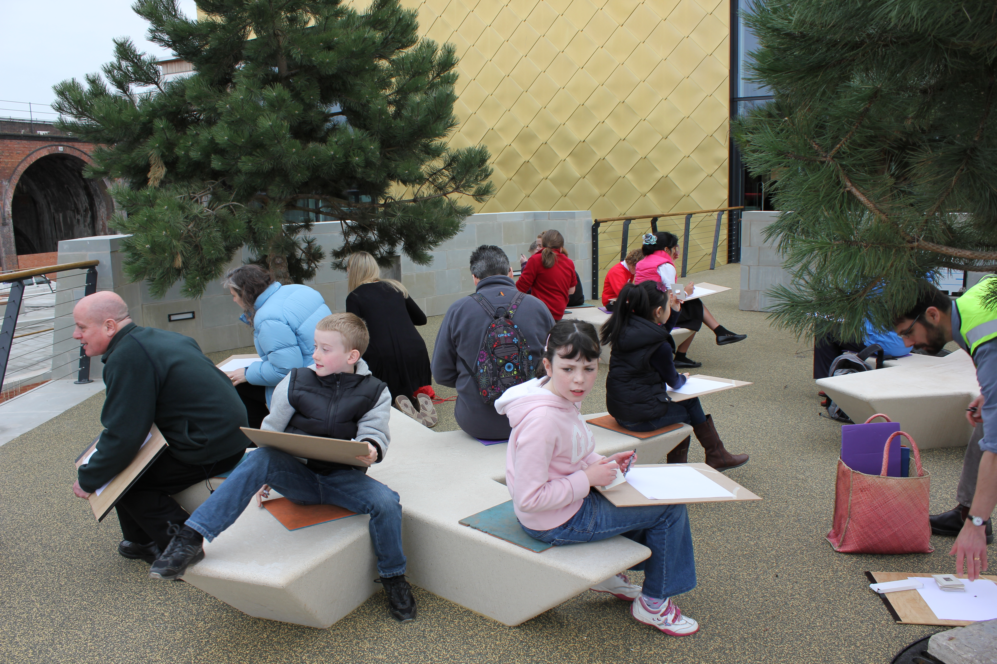
The Hive

Slide 7
Stakeholder Process
Stakeholder Advisory Forum
6 meetings
Included, university, tech college, civic society, unions, MLA council
Public county wide consultation
Parallel consultation professional bodies
Design statement
PFI process

Slide 8
Consultation for The Hive cont
Meeting with disability groups and service users
Displays in shopping centres
Market research company range of methods: older people, BME groups, parents & carers, schools, teenagers, students, LA and Uni staff, users of existing services, businesses, special interest groups and heritage partners.

Slide 9
Consultation Conclusions
Different answers common themes
Accessibility
Natural light and vaulted ceilings
Clear visibility of all floors to know where everything is
Well planned with quiet spaces well away from noisy ones
Long opening hours
Well trained welcoming staff
Notice boards
Good security
Like to use more then one service when in the building

Slide 10
Design Statement

Slide 11
Exercise
Scenario – Joint University and Council Leisure Facilities.
Working in a group discuss and commit to flip chart 2 questions.
Who are your stakeholders – 5 minutes
The process for confirming issues or identify new issues relevant for the project brief not identified by the project managers – 15 mins
You have 20 minutes then you’ll be asked to feedback.

Slide 12
Exercise- stakeholders
Access | Environment | Local Distinctiveness
How do you identify the groups with whom you’ll consult | What are your local issues, e.g. flooding | What is special about the area
Do you understand their language/issues | Are there any hidden impacts | Does it have an identity
Are you trusted | Who do you deal with | Is it recognisable regionally/nationally

Slide 13
Exercise – project objectives
Access | Environment | Local Distinctiveness
Legal compliance or beyond | Legal compliance or beyond | Distinctive, iconic or off the shelf
Inclusivity | Adaptation or mitigation or both | A sense of place
Raising benchmarks | Carbon footprint | Recognised by the community
Way finding | Life cycle | Historic references

Slide 14
Exercise – Feedback
Local distinctiveness
Access
Environment

Slide 15
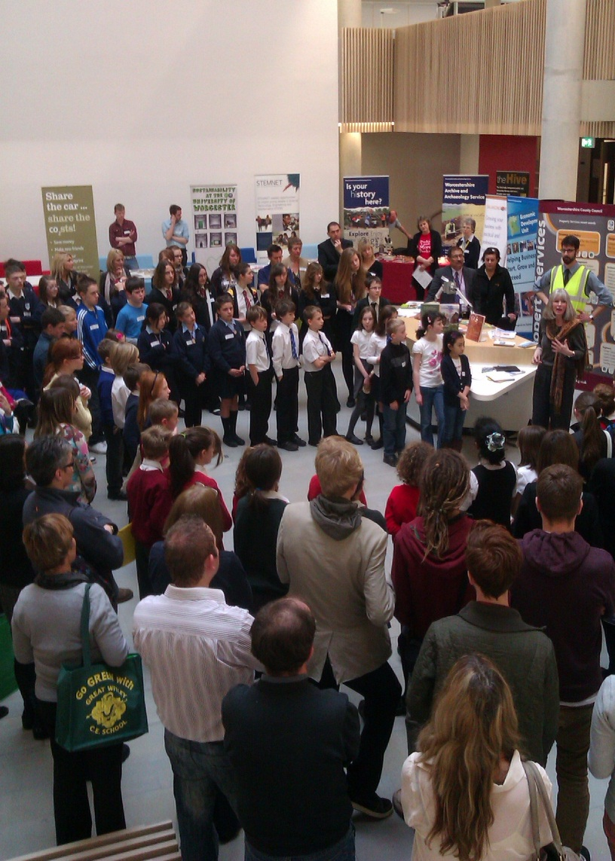
Have a clear vision
with strong leadership
Involve stakeholders
from the start
Use a framework to
keep you on track

