Slide 1
Low Carbon refurbishment of Heritage Buildings
Andy Sheppard
Arup

Slide 2
The project & team
Carbon reductions in Listed Buildings
Generic guidance document
Five case studies
Notes:
This project was all about the potential of the case study buildings to be transformed into lower carbon buildings. Will also throw in some examples of where it’s been carried out to show it is really possible.

Slide 3
Heritage Assets context
Buildings: 40% of UK carbon emissions
Whole sector zero carbon by 2050
80% of buildings already built
374,081 listed building (92% Grade II)
9,080 conservation areas
Notes:
A bit of context –
40% of UK’s emissions come from buildings
Sector as a whole needs to be zero carbon by 2050
Nearly 400,000 Listed Buildings, 9000 conservation areas

Slide 4
Guidance: Overview
The intended audience:
Planning and conservation officers
Architects
Building owners
The aim:
To demystify the process and the options

Slide 5
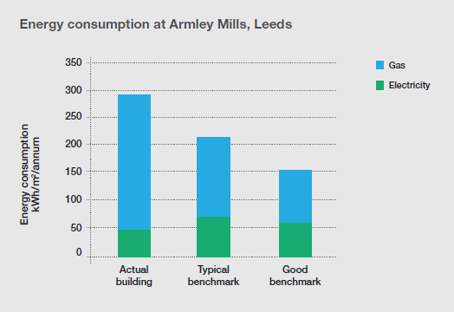
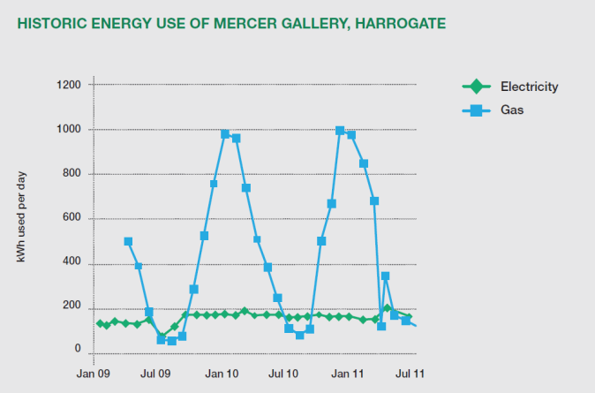
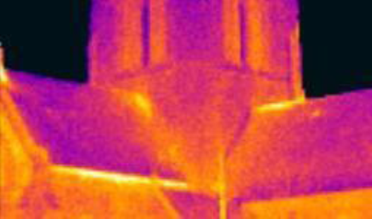
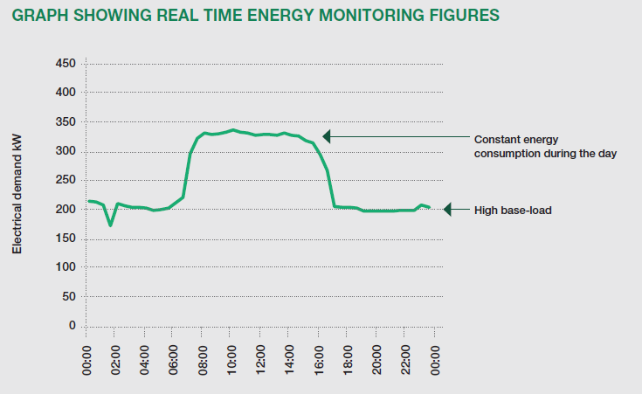
Guidance: Investigate
Bill analysis – basic but essential
Benchmarking can be challenging
Sub-metering very useful
Range of supplementary tests possible
Thermal imaging
Air pressurisation
In-situ U-value
Thermal modelling
Notes:
Benchmarking – make sure you’re comparing like-with-like and that internal conditions are satisfactory
Supplementary tests include many options. Which is carried out will depend on the which areas would seem to benefit from additional investigation.

Slide 6
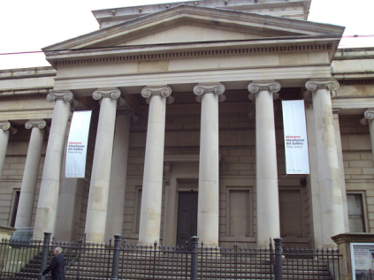
Study: Manchester Art Gallery
Lighting 50% of electrical consumption
Upgrade
LEDs
Occupancy sensors, programmable controls
Energy reduced by 89%
Next phase targeting a further 40%

Slide 7
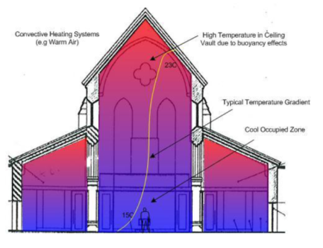
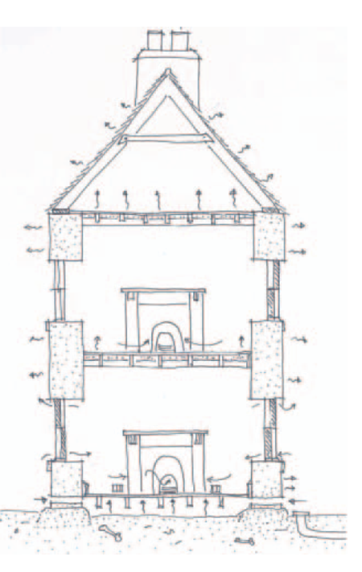
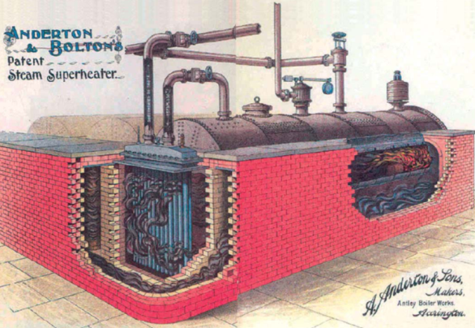
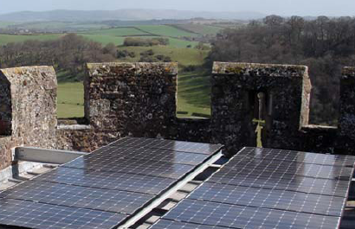
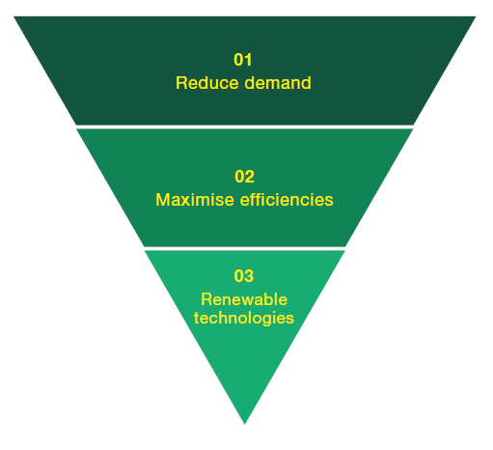
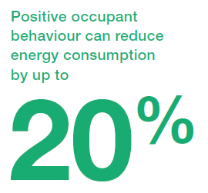
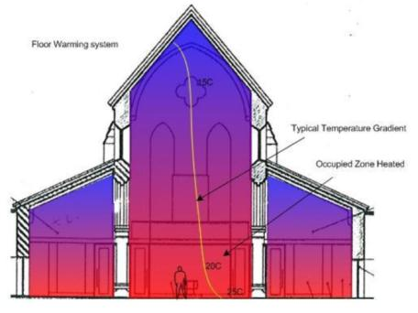
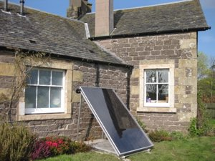
Guidance: Intervention
Think about the building as a whole
Energy hierarchy
Apply with pragmatism
Behaviour – has to be first
Fabric – possible with care
Services – more freedom
Low carbon – perfectly feasible
As necessary | Recommissioning
Minor refurbishment | Controls
Major refurbishment | Plant replacement, metering
Notes:
Holistically - There can be unexpected consequences of action:
Historic buildings need to breathe
Condensation and moisture control is important
Fabric interventions may not be feasible
Fabric – from air-tightness to insulation. Not all of most buildings are important in terms of heritage. Pick your areas carefully
Services – improvements can be incorporated into refurbishment cycles often with little on-cost over the standard like-for-like replacement

Slide 8
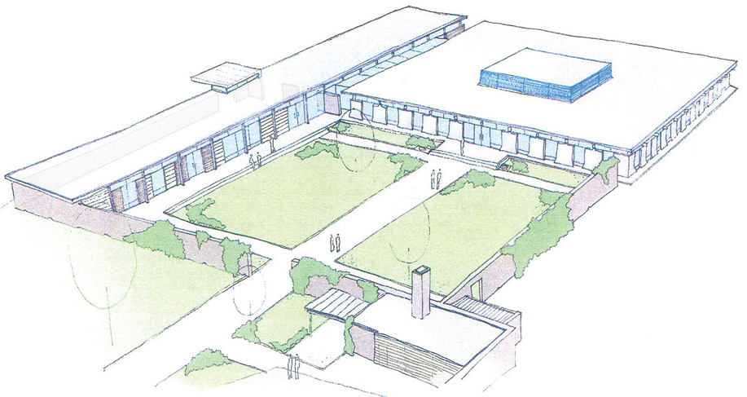
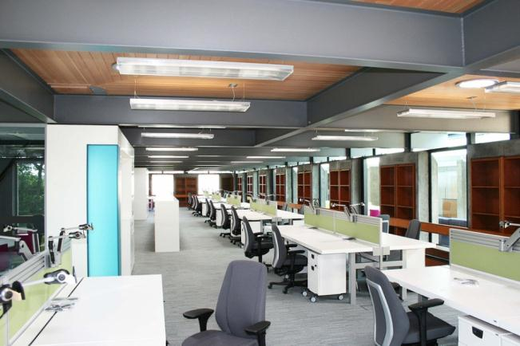
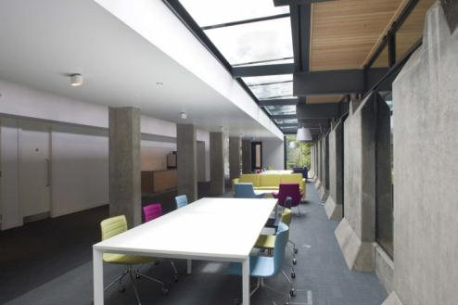
Study: Scotstoun House
Notes:
Edinburgh - Grade B listed, 1960’s. Refurbishment and extension.
Refurbishment took the 24m deep building to a natural ventilation strategy. Also biomass boiler, light-tubes, phase change thermal mass, roof passive ventilators
30% reduction in heating energy
60% reduction in lighting energy

Slide 9
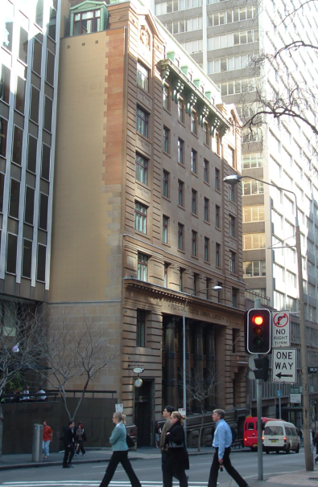
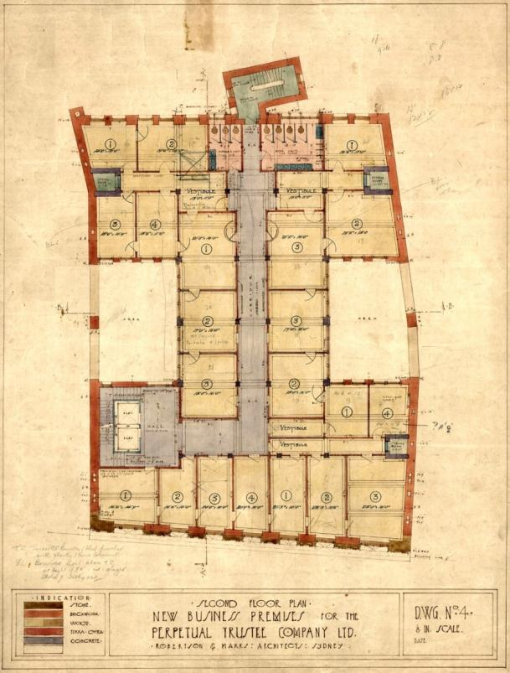
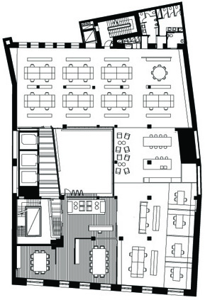
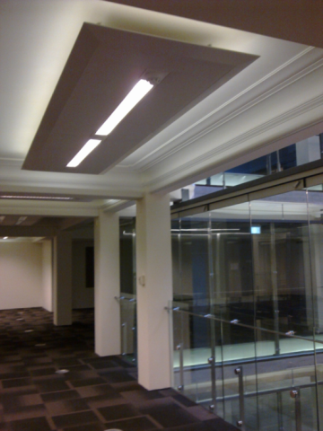
Study: 39 Hunter St, Sydney
Notes:
Constructed 1916. Permanent conservation order by NSW Heritage Council
Heavily shaded by surrounding buildings
Refurbishment greatly improved daylighting, particularly through the use of a new atrium
Removal of ceilings to expose thermal mass
Highest GreenStar Rating, 5 star energy rating. Quickly leased to Blue-chip company for 15 year term

Slide 10
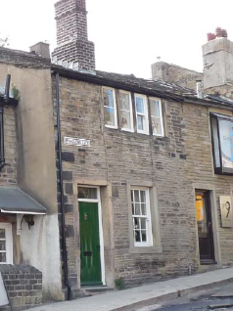
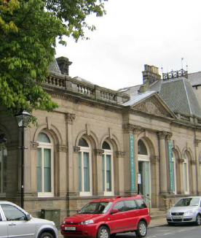
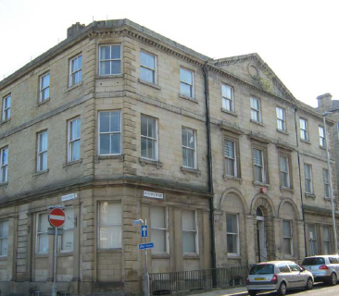
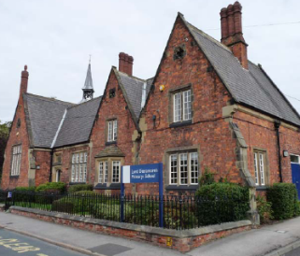
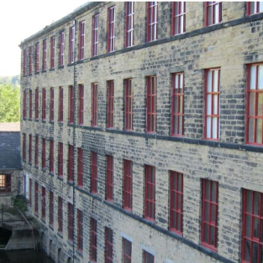
Case Studies
Heritage value & Statement of Significance
Building condition survey
Bill analysis & benchmarking
Interventions listing
Options Appraisal
Recommendations
Notes:
Heritage survey showed varying importance across the building
Condition survey invariably showed up aspects of fabric and systems that were in need of replacement so upgrades could be incorporated at a lowered on-cost

Slide 11
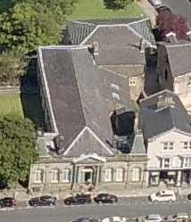
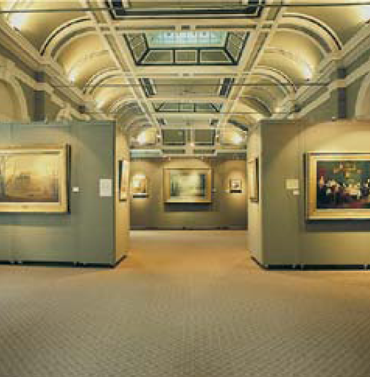
Mercer Gallery
Heritage importance within
Windows, doors and interiors
Controls, monitoring, behaviour
Larger scale interventions
Hot water system
Roof insulation (+ wall?)
LED lighting
Photovoltaics?
Elec
<5
<10
>10
!
Gas
20%
40%
60%
80%
100%
Notes:
Care over summation of intervention results

Slide 12
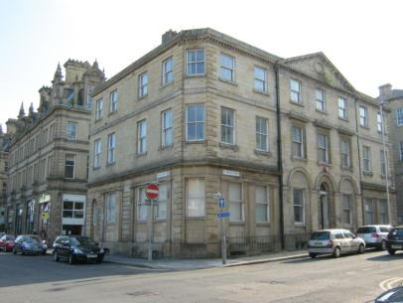
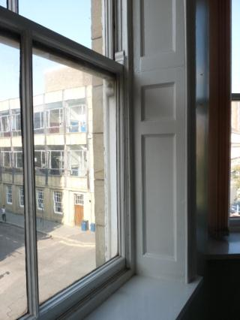
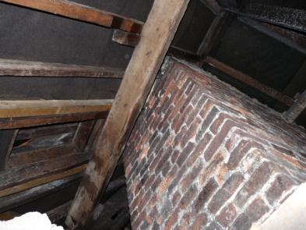
St. Peters Street
Heritage importance within
Some windows, panelled reveals, roof spaces
Unsure future use
Larger scale interventions
Loft insulation (with care)
Lighting controls
Draught stripping
Internal wall insulation feasible
High performance secondary glazing
Elec
Gas
20%
40%
60%
80%
100%

Slide 13
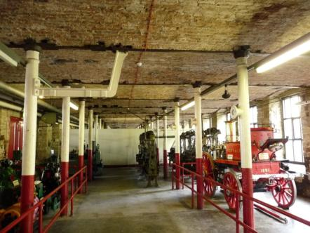
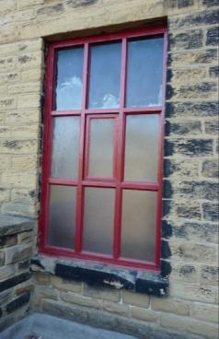
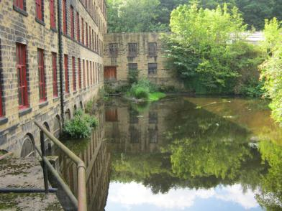
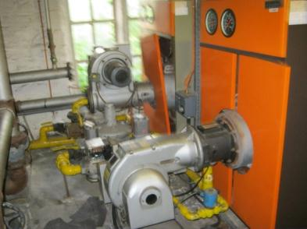
Armley Mills
Heritage importance within
Pretty much everything!
Monitoring, controls
Larger interventions
Boiler modernisation
Digital plant controls
Partial roof insulation
Daylight linking in lights
Elec
Gas
20%
40%
60%
80%
100%

Slide 14
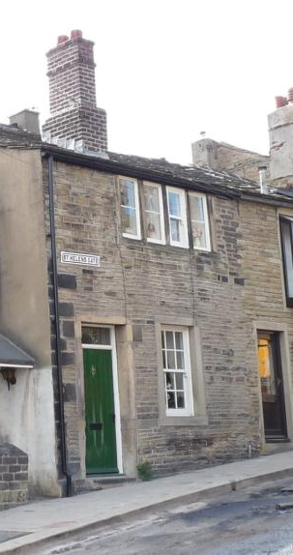
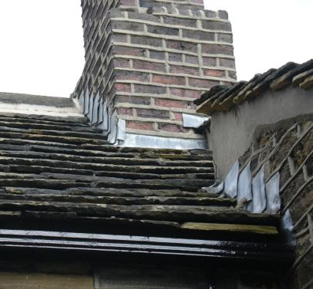
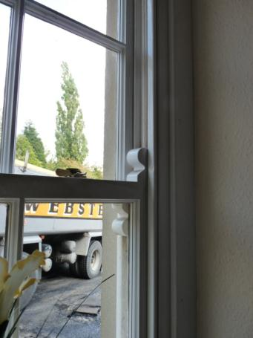
Almondbury Dwelling
Heritage importance within
Exterior walls and roof, some interior
Recently upgraded
Larger interventions
Tailor to occupant
Draught-stripping
Low energy lighting
Loft insulation
Wall, floor insulation feasible
Elec
Gas
20%
40%
60%
80%
100%
Notes:
Recent upgrades meant energy bills were unrelated to the current state of the building
Payback period of heating load reductions raises an interesting question. Should we discount paybacks at this period when the building has been around for 130 years and may well see the same again?

Slide 15
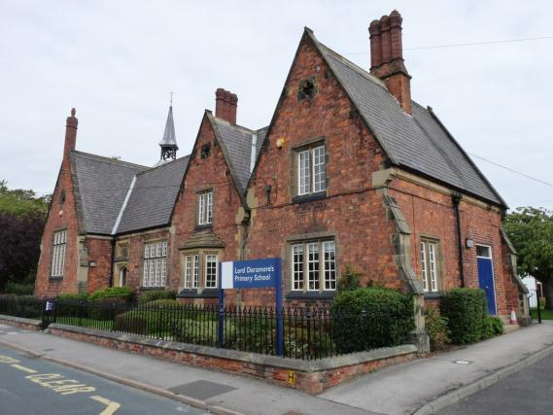
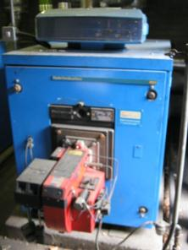
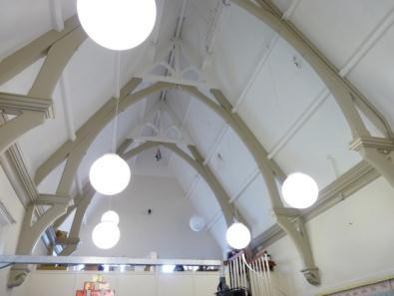
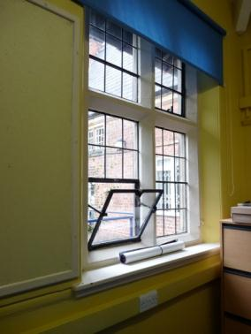
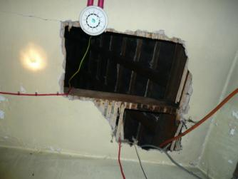
Lord Deramore’s School
Heritage importance within
Exterior, some interior
Emissions 86% heating
Larger scale interventions
Roof and wall insulation possible
Boiler system & controls
Secondary glazing
Photovoltaics
Elec
Gas
20%
40%
60%
80%
100%

Slide 16
Fabric possibilities
Maintain ventilation pathways
Be aware of bats
Heritage impact often ‘manageable’
But take care!
Longer payback
>10 years
Roof
Walls

Slide 17
Glazing possibilities
Good English Heritage research
Already in some areas
>10 year payback
Draught-proofing
Secondary gl.

Slide 18
Take away that:
The heritage process is no more difficult
Starting with the basics can yield good results
With care, larger interventions can be identified
Significant savings are possible

Slide 19
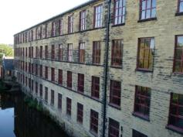
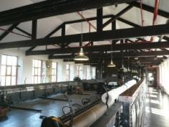
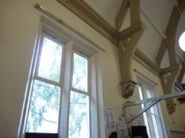
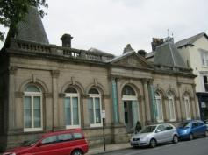
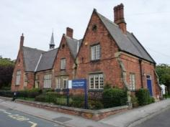
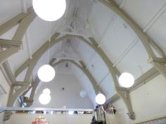
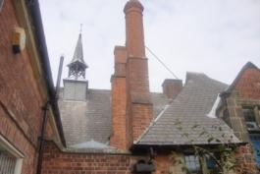
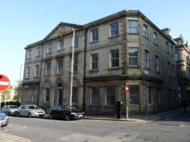
Thanks
andy.sheppard@arup.com
www.yourclimate.org/pages/low-carbon-heritage-buildings

